Slide 1
The Elements of Event Driven Programming
CHAPTER 3

Slide 2
CONTENTS
Delegates and Event Handling
Working with Components and Controls
Handling Keyboards and Mouse Events
Writing Reusable Code

Slide 3
Delegates and Event Handling
What are delegates?
How to create delegates in C#
Event Handling & Delegates in C#

Slide 4
Delegates defined.
A delegate is a type that represents references to methods with a particular parameter list and return type.
Delegates are used to pass methods as arguments to other methods.
Event handlers are nothing more than methods that are invoked through delegates.
You create a custom method, and a class such as a windows control can call your method when a certain event occurs.

Slide 5
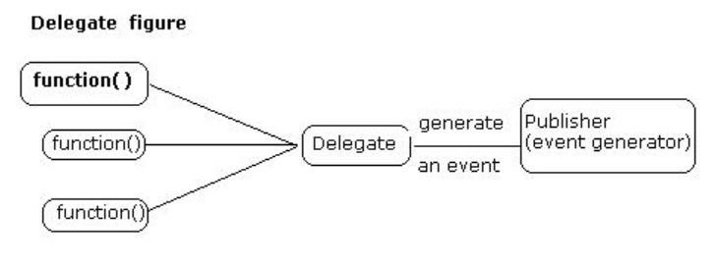
Cont.
Delegate is one of the base types in .NET. Delegate is a class used to create and invoke delegates at runtime.

Slide 6
How to use delegates in C#.
Steps followed when using delegates
Declare the delegate type
Syntax for delegate declaration is
delegate <return type> <delegate-name> <parameter list>
The next step is instantiating the delegate
Invocation or using the delegate by referencing methods via the delegate object.

Slide 7
Example
// declare a delegate
public delegate int NumberChanger(int x);
static int number = 10;
//create methods
public static int AddNum(int q)
{ number += q; return number;
}
public static int MultiplyNum(int p)
{ number +=p; return number; }
//instantiate the delegate
NumberChanger nc = new NumberChanger(AddNum);
//Invoke the delegate
MessageBox.Show(nc(5).ToString());
Output
15

Slide 8
Multicast Delegates
A useful property of delegate objects is that multiple objects can be assigned to one delegate instance by using the + operator
The multicast delegate contains a list of the assigned delegates.
When the multicast delegate is called, it invokes the delegates in the list, in order.
Note that only delegates of the same type can be combined.

Slide 9
Example
NumberChanger nc = new NumberChanger(AddNum);
nc += new NumberChanger(MultiplyNum);
nc += new NumberChanger(SubtractNum);
label1.Text = nc(10).ToString();g
Output
190

Slide 10
Event Handling and Delegates
GUIs are event driven (i.e. generate events when user interacts with the GUI).
Typical interactions that generate event include:
moving the mouse, clicking the mouse, clicking a button, typing in a textbox, selecting an item from a menu and closing a window.
Event handlers are methods that process events and perform tasks.
E.g. a form that changes color when a button is clicked.
Note that clicking the button generates an event and passes it to the event handler, and the event-handler code changes the form’s color.

Slide 11
Cont.
Each control that can generate events has an associated delegate that defines the signature for that control’s event handlers.
Delegates are objects that reference methods.
Event delegates are multicast (class MulticastDelegate)—they contain lists of method references.
Each method must have the same signature (i.e., the same list of parameters).
In the event-handling model, delegates act as intermediaries between objects that generate events and methods that handle those events.

Slide 12
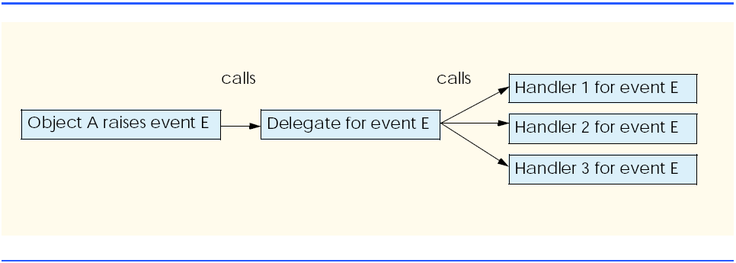
Once an event is raised, every method that the delegate references is called.
Every method in the delegate must have the same signature, because they are all passed the same information.
Event-handling mode

Slide 13
How to create events?
In most cases, we do not have to create our own events.
Instead, we can handle the events generated by .NET controls such as buttons and text boxes.
These controls already have delegates for every event they can raise.
The programmer creates the event handler and registers it with the delegate—Visual Studio .NET helps with this task.
Example of windows application that displays a message box when clicked.

Slide 14
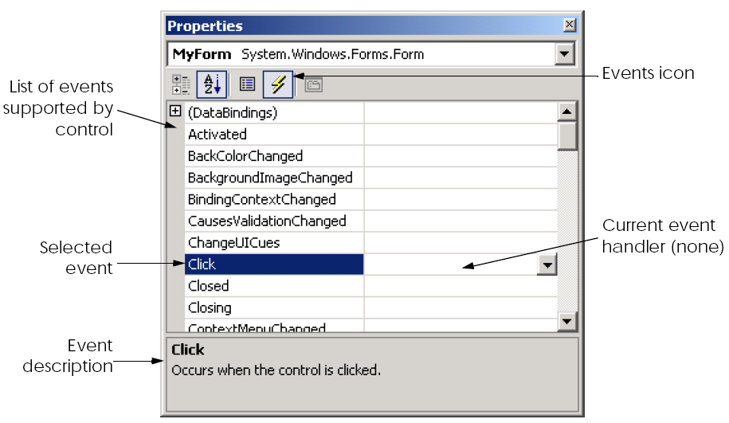
First, create a new Windows application.
To register and define an event handler, click the Events icon in the form’s Properties window.
This window allows the programmer to access, modify and create event handlers for a control.
The dropdown button indicates that multiple handlers can be registered for one event.
A brief description of the event appears on the bottom of the window.

Slide 15
Description of an event handler
Every event handler must have the signature that the corresponding event delegate specifies.
Event handlers are passed two object references.
a reference to the object that raised the event (sender), and
a reference to an event arguments object (e).
Argument e is of type EventArgs. Class EventArgs is the base class for objects that contain event information.

Slide 16
Cont.
The format of the event-handling method is:
void ControlName_EventName( object sender, EventArgs e )
{
event-handling code
}
Where
event handler name is by default the name of the control, followed by an underscore (_) and the name of the event.
have return type void and
take two arguments—an object (usually sender) and an instance of an event argument class.

Slide 17
NORMAN’S DESIGN PRINCIPLES

Slide 18
Principles of good GUI design
Donald Norman is a renowned researcher who has worked in the field of Human Computer Interaction(HCI) .
Norman provides six key design principles to keep in mind while designing any interface.
Norman’s idea centers around usability of any device, computers or applications. i.e an app should function correctly, be intuitive and easy to use.
The following six principle revolve around that.

Slide 19
Cont.
Visibility: Users should know, just by looking at an interface, what their options are and how to access them.
e.g. the hamburger in mobile design
Feedback: The user must receive feedback after every action they perform to let them know whether or not their action was successful.
E.g Google’s loading indicator
Affordance: is the link between how things look and how they’re used. Users need to be able to tell how to access information they want from a website, or else they’ll just leave.

Slide 20
Cont.
Mapping: is the idea that, in a good design, the controls for something will closely resemble their effect.
e.g. Vertical scroll bar
Constraints(input validation): restrict a particular form of user interaction with an interface. This is essential because the user could become overwhelmed with the range of possibilities available through an interface.
Consistency: people learn new things and manage better when they recognize patterns.

Slide 21
Cont.
After creating the event handler, we must register it with the delegate object, which contains a list of event handlers to call.
Registering an event handler with a delegate object involves adding the event handler to the delegate’s invocation list.
Controls have a delegate reference for each of their events—the delegate reference has the same name as the event.
E.g. if we are handling event EventName for object myControl, then the delegate reference is myControl.EventName.
Visual Studio .NET registers events for us with code such as the following from method InitializeComponent:
this.Click += new System.EventHandler( this.MyForm_Click );

Slide 22
Common Controls

Slide 23
Control Properties and Layout
Controls derive from class Control (namespace System.Windows.Forms).
Text property - specifies the text that appears on a control. It vary depending on the context.
E.g. the text of a Windows Form is its title bar, and the text of a button appears on its face.
The Focus method transfers the focus to a control. When the focus is on a control, it becomes the active control.
TabIndex property - determines the order in which controls are given focus.
automatically set by Visual Studio .NET, but can be changed by the programmer.
helpful for the user who enters information in many different locations—the user can enter information and quickly select the next control by pressing the Tab key.

Slide 24
Cont.
Enabled property - indicates whether the control can be used.
Programs can set property Enabled to false when an option is unavailable to the user.
Visible property - without having to disable a control, the control can be hidden from the user by setting the Visible property to false or by calling method Hide.

Slide 25
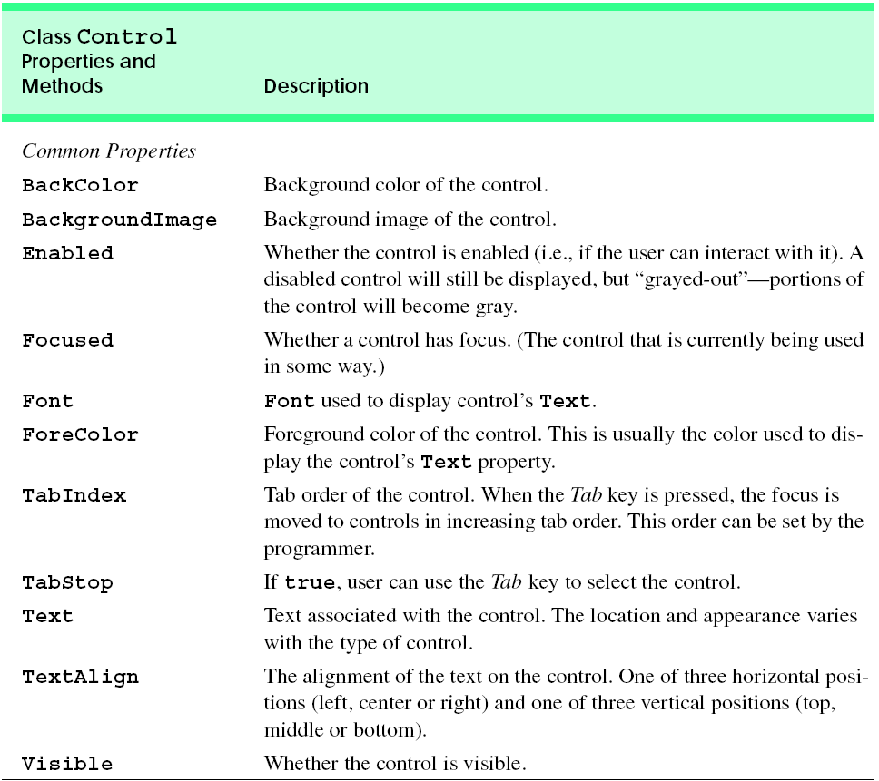

Slide 26
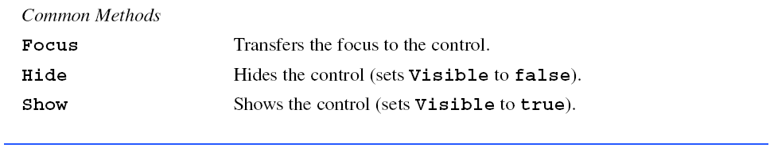

Slide 27
Layout class - properties
Visual Studio .NET allows the programmer to anchor and dock controls, which help to specify the layout of controls inside a container (such as a form).
Anchoring - allows controls to stay a fixed distance from the sides of the container, even when the control is resized.
Docking - allows controls to extend themselves along the sides of their containers.
E.g. – if you want a control to appear in a certain position (top, bottom, left or right) in a form even when that form is resized.
specify this by anchoring the control to a side (top, bottom, left or right).
In most cases, the parent container is a form; however, other controls can act as a parent container.

Slide 28
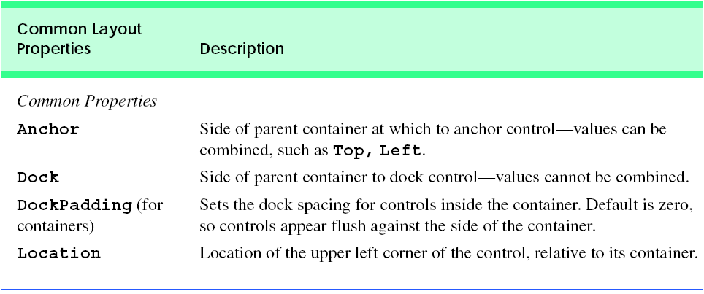
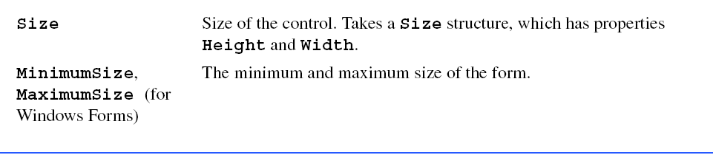

Slide 29
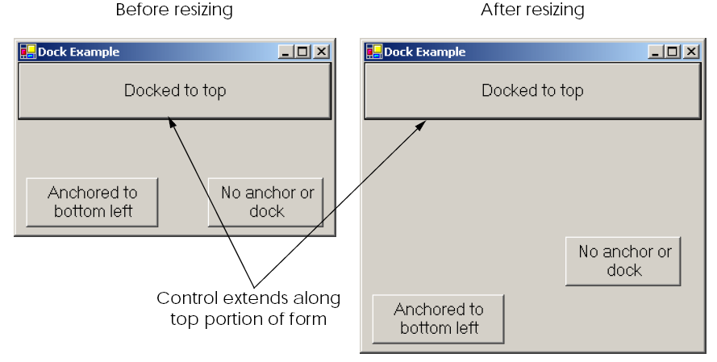
Docking and anchoring demo

Slide 30
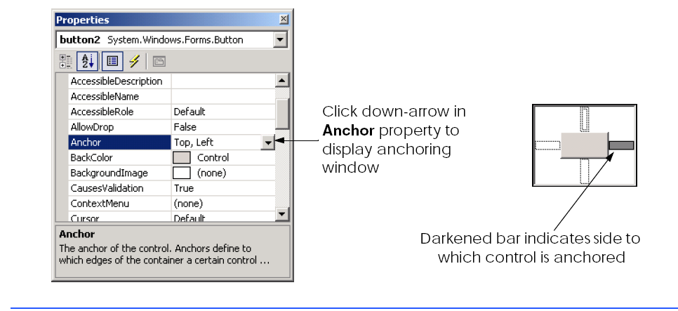

Slide 31
Cont.
The docking and anchoring options refer to the parent container, which may or may not be the form.
The minimum and maximum form sizes can be set using properties MinimumSize and MaximumSize, respectively.
Both properties use the Size structure, which has properties Height and Width, specifying the size of the form.
These properties allow you to design the GUI layout for a given size range.
To set a form to a fixed size, set its minimum and maximum size to the same value.

Slide 32
Labels, TextBoxes and Buttons
Labels provide text instructions or information about the program.
Labels are defined with class Label (derives from class Control).
A Label displays read-only text/ can’t modified by user.
A textbox (class TextBox) is an area in which text can be either input by the user from the keyboard or displayed.
A password textbox is a TextBox that hides what the user entered.
As the user types in characters, the password textbox displays only a certain character (usually *).
Altering the PasswordChar property of a textbox makes it a password textbox.
Deleting the value of PasswordChar in the Properties window sets the textbox back to a regular textbox.

Slide 33
Cont.
A button is a control that the user clicks to trigger a specific action.
Other types of buttons, include checkboxes and radio buttons.
All button types are derived from ButtonBase (namespace System.Windows.Forms) 🡪 defines common button features.
Button is often used to initiate a command.
The text on the face of a Button is called a button label.
Demo - create a program that uses a TextBox, a Button and a Label.
The user enters text into a password box and clicks the Button. The text then appears in the Label. Normally, we would not display this text—the purpose of password textboxes is to hide the text being entered by the user from anyone who may be looking over a person’s shoulder.

Slide 34
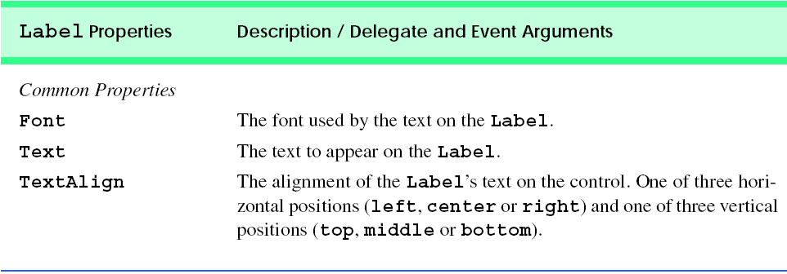
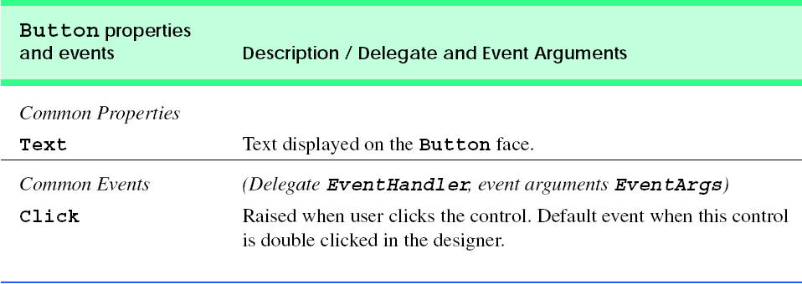

Slide 35
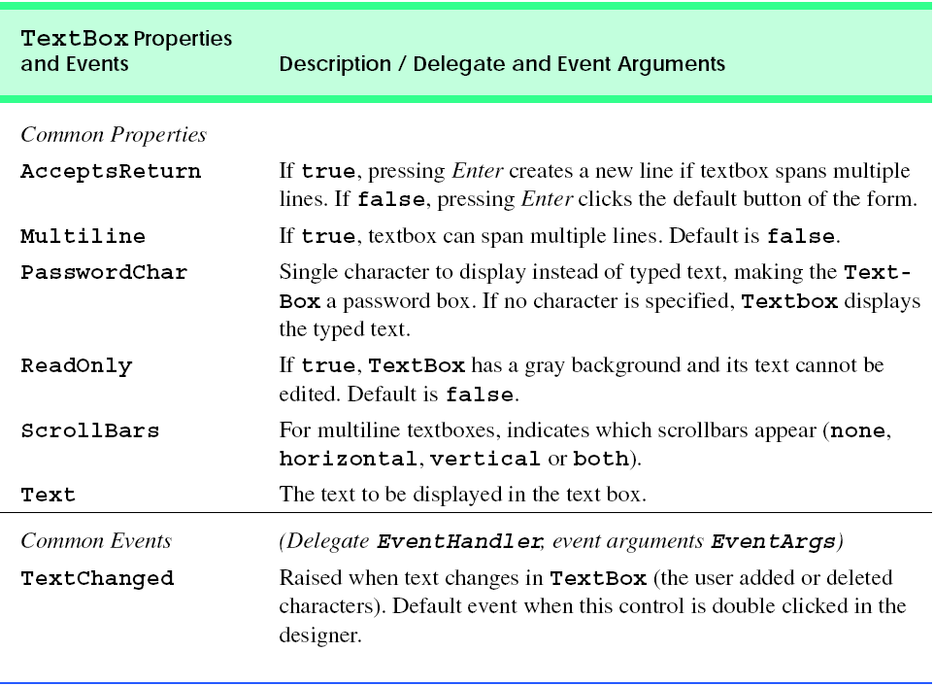
Common TextBox properties and events

Slide 36
